Slide 1

Workshop on Java Programming
Interactive Health Solutions
Interactive Research & Development
Indus Hospital Research Centre
Mohammad Ali Jinnah University

Slide 2
You, Us and the Workshop
Introduction
Workshop Format
Course Outlines
Assignments
Material and Resources
Notes:
Time: 20 + 10 + 5 + 10 + 5

Slide 3
Course Outlines – Day 1
Introduction to Java Language
Bytecode, JVM, JRE & JDK
Setting up Programming Environment
Writing your first Program
Common Eclipse Commands
Comments, Indentation and Conventions
Variables, Operators and Statements
Notes:
Time: 5

Slide 4

Why Java?
High-level
Object-Oriented
Platform Independent
Open Source
Frameworks
Notes:
Time: 10

Slide 5
How Java works
Source code
Byte code
Java Virtual Machine (JVM)
Java Runtime Environment (JRE)
Just in-time Compiler (JIT)
Java Development Kit (JDK)
Notes:
Time: 20

Slide 6
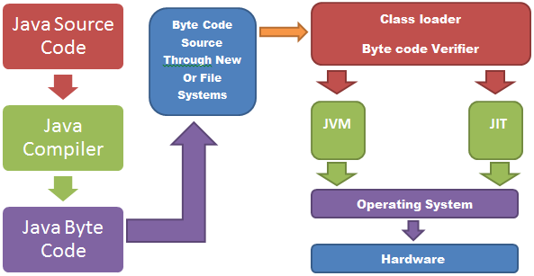
How Java works
JDK
JRE
Notes:
Example on slide 20 of “1 Getting Started.pdf”

Slide 7
Setting up the Environment
Pre-requisites
Oracle JDK or Open JDK
Eclipse IDE for JEE (Juno 4.2 or higher)
Eclipse
Startup
Define Workspace
Set up JDK
That’s it
Notes:
Time: 30

Slide 8
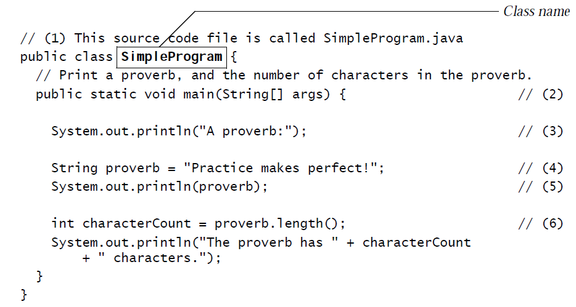
Writing your first Program
Create new Project
Write your first Java code

Slide 9
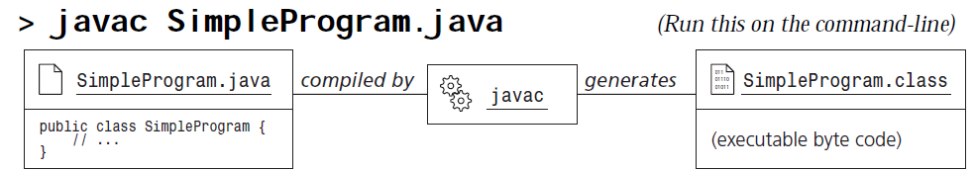
Writing your first Program
Compile and Build (auto and manual)
Run
Behind the Scene
Notes:
Expected Time: 2h 30mins

